Slide 1
Virtual Functions
Prepared By: Sumaiya Binte Shahid
Lecturer
Department of CSE, BUBT

Slide 2
Pointers To Derived Classes
A pointer declared as a pointer to a base class can also be used to point to any class derived from that base. For example, assume two classes called base and derived, where derived inherits base.
base *p; // base class pointer
base base_ob ; // object of type base
derived derived_ob ; // object of type derived
p = & base_ob ; // p points to base object
p = & derived_ob ; // p points to derived object
One can use a base pointer to point to a derived object, one can access only those members of the derived object that were inherited from the base. This is because the base pointer has knowledge only of the base class. It knows nothing about the members added by the derived class.

Slide 3
Pointers To Derived Classes
While it is permissible for a base pointer to point to a derived object, the reverse is not true.
A pointer of the derived type cannot be used to access an object of the base class. (A type cast can be used to overcome this restriction, but its use is not recommended practice.)
Pointer arithmetic is relative to the data type the pointer is declared as pointing to. Thus, if you point a base pointer to a derived object and then increment that pointer, it will not be pointing to the next derived object. It will be pointing to (what it thinks is) the next base object.

Slide 4
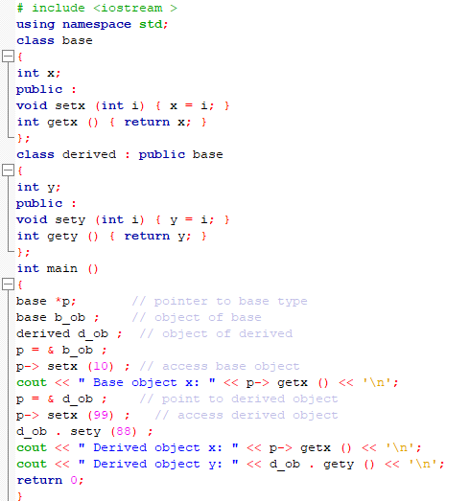
Pointers To Derived Classes

Slide 5
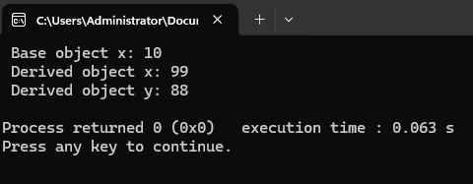
Pointers To Derived Classes
Explanation: A base pointer (p) can only interact with members inherited from the base class, even when pointing to a derived object. To access derived-specific members, the derived object must be used directly, as seen with d_ob accessing sety() and gety(). This behavior highlights how base class pointers are restricted to base-level knowledge, ensuring compatibility in inheritance hierarchies.

Slide 6
Pointers To Derived Classes
Task: On your own, try the preceding example and experiment with it. For example, try declaring a derived pointer and having it access an object of the base class.

Slide 7
Compile-time Polymorphism and Runtime Polymorphism
Aspect | Compile-Time Polymorphism | Runtime Polymorphism
Definition | In compile-time polymorphism, the call is resolved at compile time. | In runtime polymorphism, the call is not resolved by the compiler.
Binding | It is also known as static binding, early binding, or overloading. | It is also known as dynamic binding, late binding, or overriding.
Method Overloading/Overriding | Achieved by using the same method name but with different arguments or parameters in the same or different scope. | Achieved by overriding methods in the derived classes to suit their requirements.
Techniques | Achieved by function overloading and operator overloading. | Achieved by virtual functions and pointers.
Execution Speed | Provides fast execution because the method to be executed is known early at compile time. | Provides slow execution as compared to compile-time polymorphism because the method to be executed is known at runtime.

Slide 8
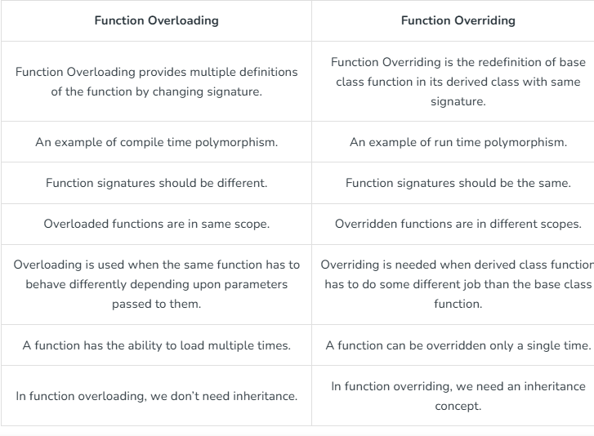
Function Overloading vs Function Overriding

Slide 9
Virtual Function
A virtual function (also known as virtual methods) is a member function that is declared within a base class and is re-defined (overridden) by a derived class. When you refer to a derived class object using a pointer or a reference to the base class, you can call a virtual function for that object and execute the derived class’s version of the method.
Virtual functions ensure that the correct function is called for an object, regardless of the type of reference (or pointer) used for the function call.
They are mainly used to achieve Runtime polymorphism.
Functions are declared with a virtual keyword in a base class.
The resolving of a function call is done at runtime.

Slide 10
Rules for Virtual Functions
The rules for the virtual functions in C++ are as follows:
Virtual functions cannot be static.
A virtual function can be a friend function of another class.
Virtual functions should be accessed using a pointer or reference of base class type to achieve runtime polymorphism.
The prototype of virtual functions should be the same in the base as well as the derived class.
They are always defined in the base class and overridden in a derived class. It is not mandatory for the derived class to override (or re-define the virtual function), in that case, the base class version of the function is used.

Slide 11
Static Member Functions
These functions belong to the class itself, not to any specific object.
They can only access static members of the class, which are shared among all objects of that class.
No this pointer is passed because static functions don’t operate on individual object data.
You can call static functions without creating an object.
class Car {
static int totalCars; // static member (shared by all Car objects)
public:
static void setTotalCars(int count) { // static function
totalCars = count; }
static int getTotalCars() {return totalCars; }};
int main()
{ Car::setTotalCars(5);
cout << "Total Cars: " << Car::getTotalCars() << endl;
Return 0;}

Slide 12
Non- Static Member Functions
These functions belong to individual objects of a class.
Every time you create an object, that object has its own separate copy of the non-static data members, and non-static functions work on that data.
Non-static functions can access both static and non-static members (variables or functions) of the class.
The this pointer is passed to non-static functions, which points to the current object calling the function. This allows the function to know which object's data to use.
class Car {
int speed; // non-static member
public:
void setSpeed(int s) { // non-static function
speed = s; // works on the speed of the object calling it
}};

Slide 13
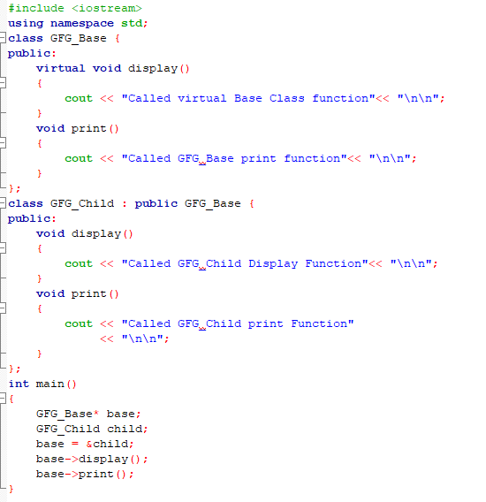
Virtual Functions

Slide 14
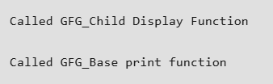
Virtual Function
Virtual Function (display): The function display in GFG_Base is declared as virtual. This allows GFG_Child to override display with its own version. When you call base->display(), the actual object type (in this case, GFG_Child) determines which version of the function to execute. So, base->display() calls the GFG_Child's version of display.
Non-Virtual Function (print): The function print in GFG_Base is not virtual. This means the function is resolved at compile time, based on the type of the pointer (GFG_Base*). So, base->print() calls the GFG_Base's version of print, even though the pointer points to a GFG_Child object.
Explanation:

Slide 15
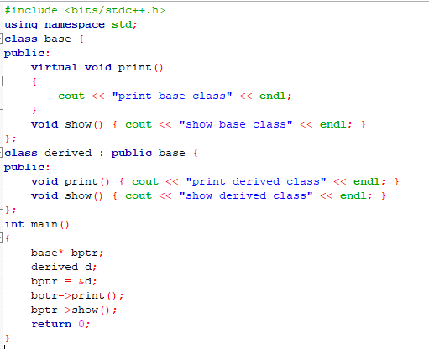
Virtual Functions

Slide 16

Virtual Function
Virtual Function: The function print in base is declared as virtual. This allows derived to override print with its own version. When you call bptr->print(), the actual object type (in this case, derived) determines which version of the function to execute. So, bptr->print() calls the derive’s version of print.
Non-Virtual Function (display): The function display in base is not virtual. This means the function is resolved at compile time, based on the type of the pointer (base*). So, bptr->display(), calls the base's version of display, even though the pointer points to a derive object.
Explanation:

Slide 18
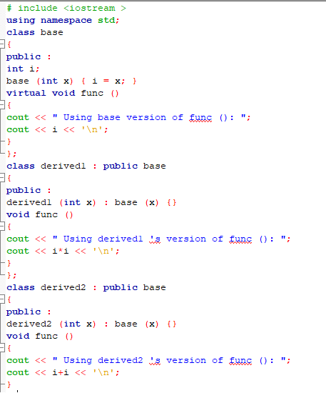
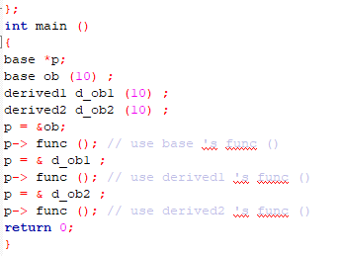
Virtual Functions

Slide 19
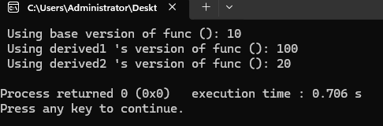
Virtual Function
Explanation: As you can see, the example program creates three classes. The base class defines the
virtual function func(). This class is then inherited by both derived1 and derived2. Each of these classes overrides func() with its individual implementation. Inside main(), the base class pointer p is declared along with objects of type base, derived1, and derived2. First, p is assigned the address ob ob (an object of type base). When func() is called by using [, it is the version in base that is used. Next, p is assigned the address of d ob1 and func() is called again. Because it is the type of the object pointed to that determines which virtual function will be called, this time it is the overridden version in derived1 that is executed. Finally, p is assigned the address of d ob2 and func() is called again, This time, it is the version of func() defined inside derived2 that is executed.

Slide 20
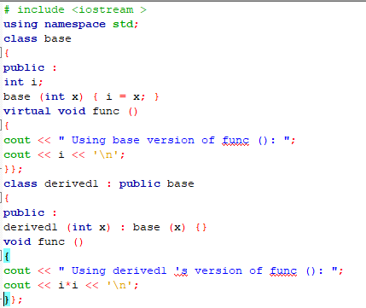
Virtual Functions
Virtual functions are hierarchical in order of inheritance. Further, when a derived class does not override a virtual function, the function defined within its base class is used. For example, here is a slightly different version of the preceding program:

Slide 21
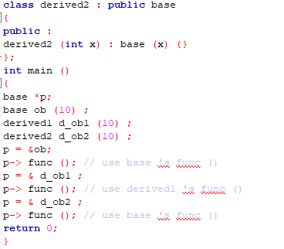
Virtual Functions

Slide 22
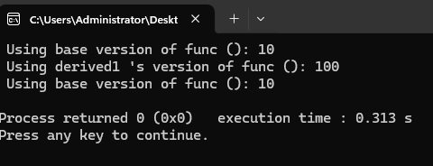
Virtual Function
Explanation: In this version, derived2 does not override func(). When p is assigned d ob2 and func() is called, base's version is used because it is next up in the class hierarchy. In general, when a derived class does not override a virtual function, the base class's version is used.

Slide 23
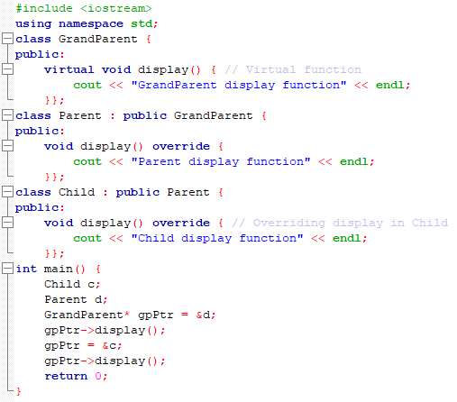
Virtual Functions
It is allowed to call the virtual function of the grandparent class from the child class in case of multilevel inheritance. Virtual functions ensure that the most overridden version of the function is invoked, depending on the actual type of the object being used.

Slide 24
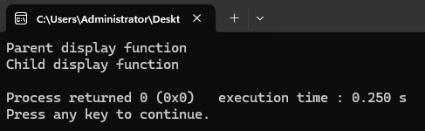
Virtual Function
If you use a GrandParent* or Parent* pointer to refer to the Child object, the virtual function mechanism ensures that the Child's overridden version of display() is called. Even though the function is overridden at each level, you can still directly access the base class versions when needed.

Slide 25
Advantages of using Virtual Function
The derived class's overridden method is executed, even when a base class pointer/reference is used.
base->display(); // Calls Derived class method, if base points to a derived object.
This behavior is resolved at runtime (called runtime binding or dynamic dispatch).
In large applications, you might have multiple derived classes from a common base class. With virtual functions, you can create generic code that can handle different derived classes dynamically. For example, if you have multiple shapes like Circle, Rectangle, and Triangle derived from Shape, you can write:
Shape* shape = getShape(); // Dynamically return any type of shape
shape->draw(); // Correct `draw` method is called (Circle, Rectangle, or Triangle)
Without virtual functions, you would need to manually check the type of the object and call the appropriate method.
Virtual functions allow you to use the same interface for multiple derived classes. You don’t need to rewrite or duplicate code for each derived class. You can write code once in terms of the base class and let the derived classes implement specific behaviors.

Slide 26
Pure Virtual Function & Abstract Class
A pure virtual function (or abstract function) in C++ is a virtual function for which we can have an implementation, But we must override that function in the derived class, otherwise, the derived class will also become an abstract class.
A pure virtual function is declared by assigning 0 in the declaration.
Sometimes implementation of all functions cannot be provided in a base class because we don’t know the implementation. Such a class is called an abstract class.
For example, let Shape be a base class. We cannot provide the implementation of function draw() in Shape, but we know every derived class must have an implementation of draw(). Similarly, an Animal class doesn’t have the implementation of move() (assuming that all animals move), but all animals must know how to move. We cannot create objects of abstract classes.

Slide 27
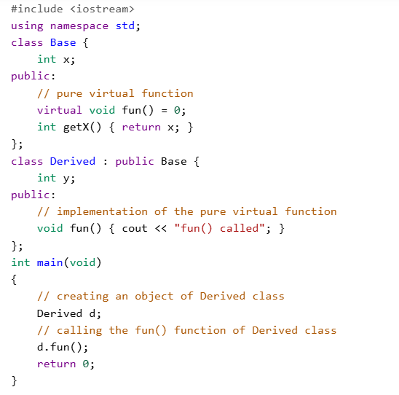
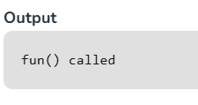
Pure
Virtual
Functions

Slide 28
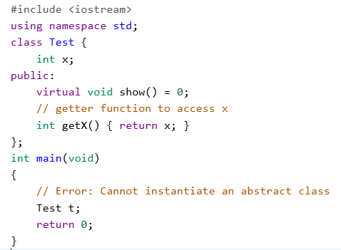
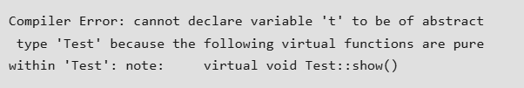
Facts on Pure Virtual Functions & Abstract Class
1. A class is abstract if it has at least one pure virtual function.

Slide 29
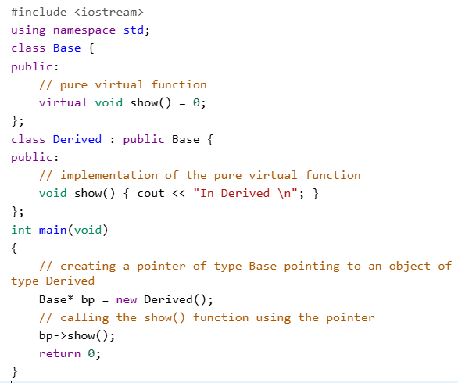
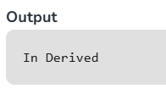
Facts on Pure Virtual Functions & Abstract Class
2. We can have pointers and references of abstract class type.

Slide 30
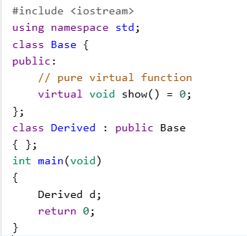
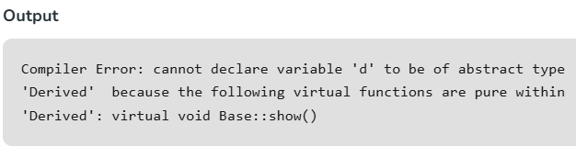
Facts on Pure Virtual Functions & Abstract Class
3. If we do not override the pure virtual function in the derived class, then the derived class also becomes an abstract class.

Slide 31
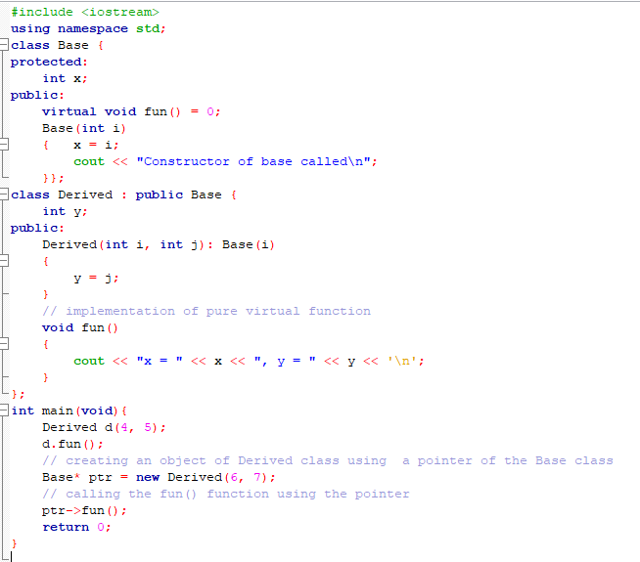
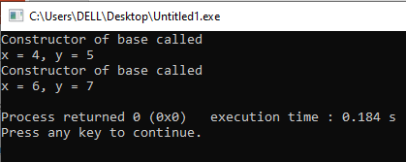
Facts on Pure Virtual Functions & Abstract Class
4. An abstract class can have constructors.

Slide 32
Facts on Pure Virtual Functions & Abstract Class
5. An abstract class in C++ can also be defined using struct keyword.
Example
struct shapeClass { virtual void Draw()=0; }

Slide 33
Virtual Functions vs Pure Virtual Functions
Virtual function | Pure virtual function
A virtual function is a member function of base class which can be redefined by derived class. | A pure virtual function is a member function of base class whose only declaration is provided in base class and should be defined in derived class otherwise derived class also becomes abstract.
Classes having virtual functions are not abstract. | Base class containing pure virtual function becomes abstract.
Definition is given in base class. | No definition is given in base class.
Base class having virtual function can be instantiated i.e. its object can be made. | Base class having pure virtual function becomes abstract i.e. it cannot be instantiated.
If derived class does not redefine virtual function of the base class, then it does not affect compilation. | If derived class does not redefine virtual function of the base class, then no compilation error is encountered, but like the base class, derived class also becomes abstract.

Slide 34
(a) Create a simple ‘shape’ hierarchy: a base class called Shape and derived classes called Circle, Square, and Triangle. In the base class, make a virtual function called draw( ), and override this in the derived classes.

Slide 35
Design a C++ program to demonstrate the use of inheritance, pure virtual functions, and runtime polymorphism in a library system.
Requirements:Create an abstract base class named LibraryItem that contains:
Protected data members:string title
int itemID
A function void setData(string t, int id) to set these values.
A pure virtual function int getBorrowDays() that returns the number of days an item can be borrowed.
A virtual function void display() to show basic information.
Derive the following classes from LibraryItem:Book: includes author name and number of pages.Borrow period = 14 days
Magazine: includes issue number.Borrow period = 7 days
Override the display() function to show detailed information. In the main() function:Create individual objects for each derived class.Use a base class pointer (LibraryItem*) to refer to these objects one by one.Call display() through the base pointer to show runtime polymorphism in action.

Slide 36

Thank You

